Slide 1
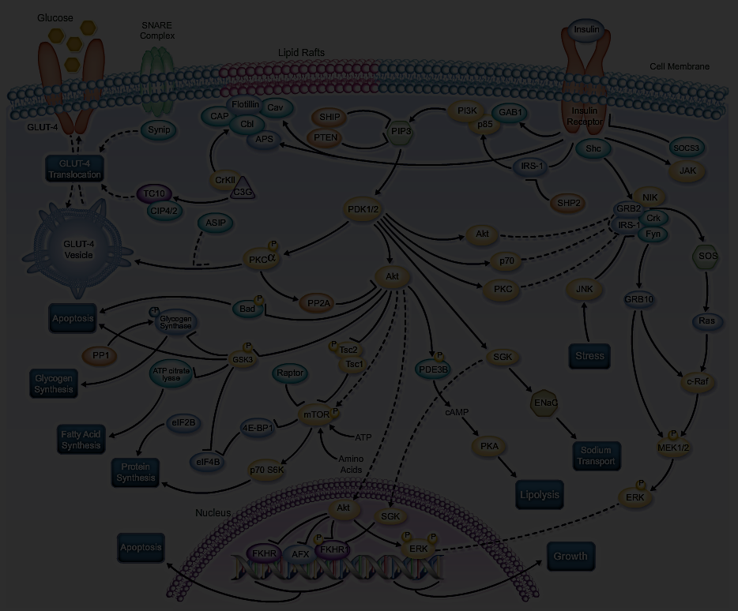
Predict Novel Kinase-Substrate by Using Positive Unlabelled Dataset
Presented by Group 19:
Amber Fang, 470171497
Luna Liu, 470327120
Kurniawan Pranogo Panjiarto, 460773970
Yangkai Hong, 470231528
Steven Wang, 308047990

Slide 2
Feature Engineering
Compute variance of the 8 time-point observations.
Calculate PSSM from sequence of motif.
Sequence of motif feature data conversion (Idea of TF-IDF)
Sequence of motif feature augmentation (Idea of ngram combinations)
Using t-Distribution Stochastic Neighbouring Embedding to Visualize data
DBSCAN Clustering on t-SNE output
Phosphoproteomic Variable interactions
Feature importance and correlation study
Scaling and PCA

Slide 3
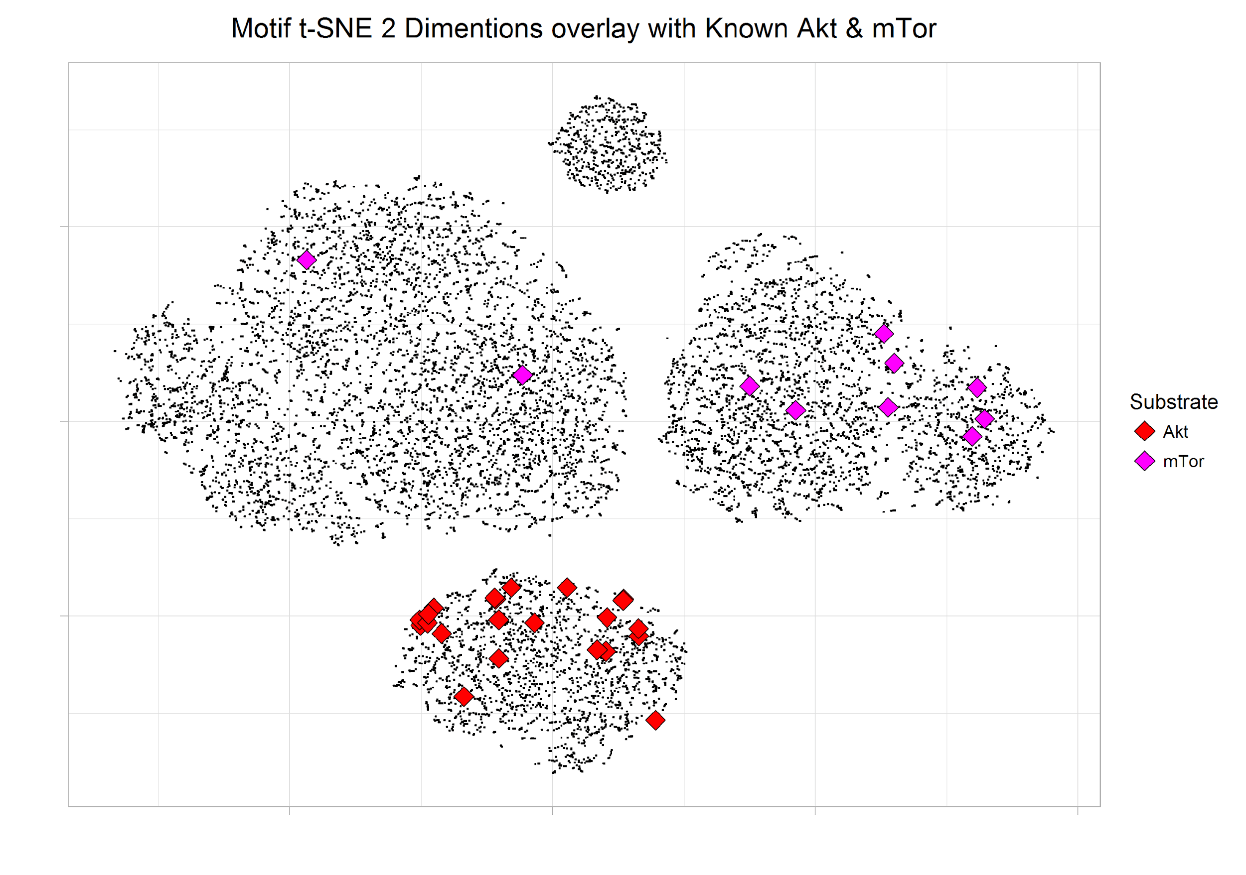
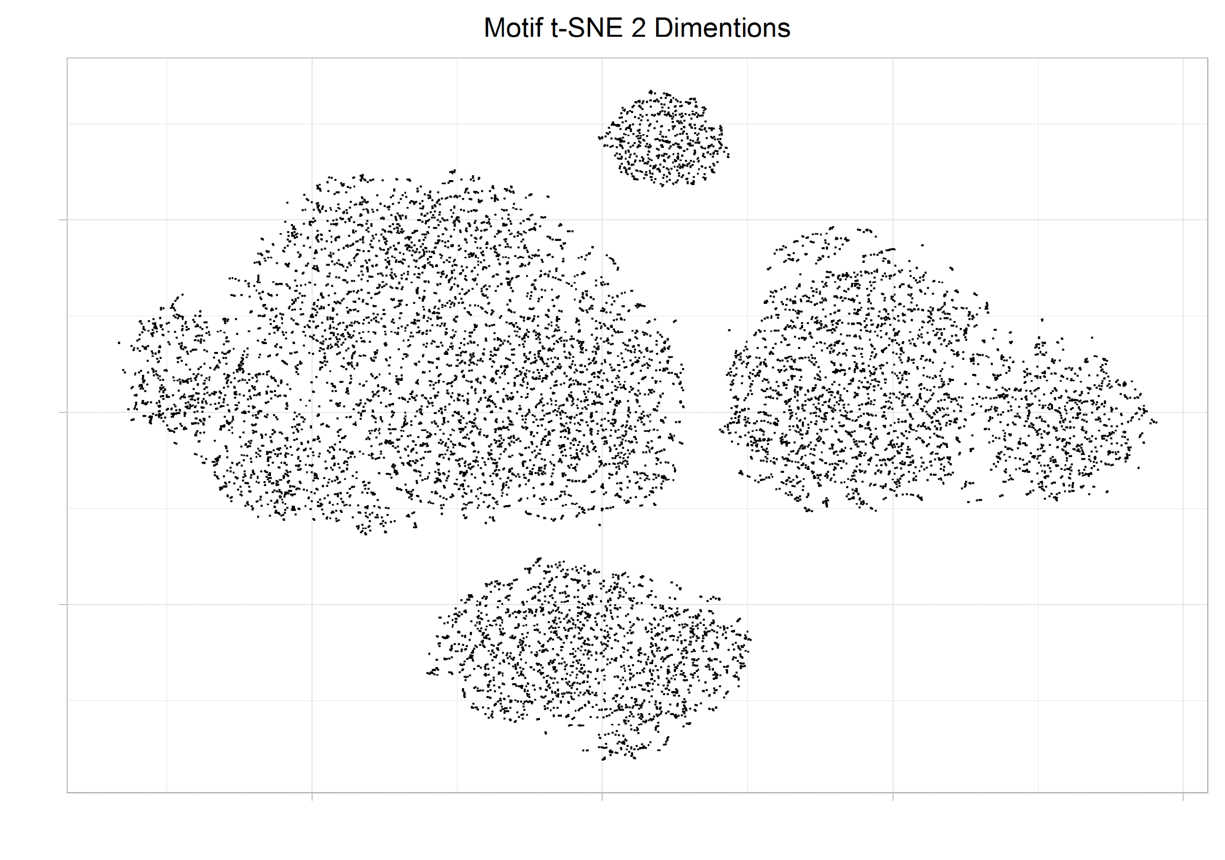
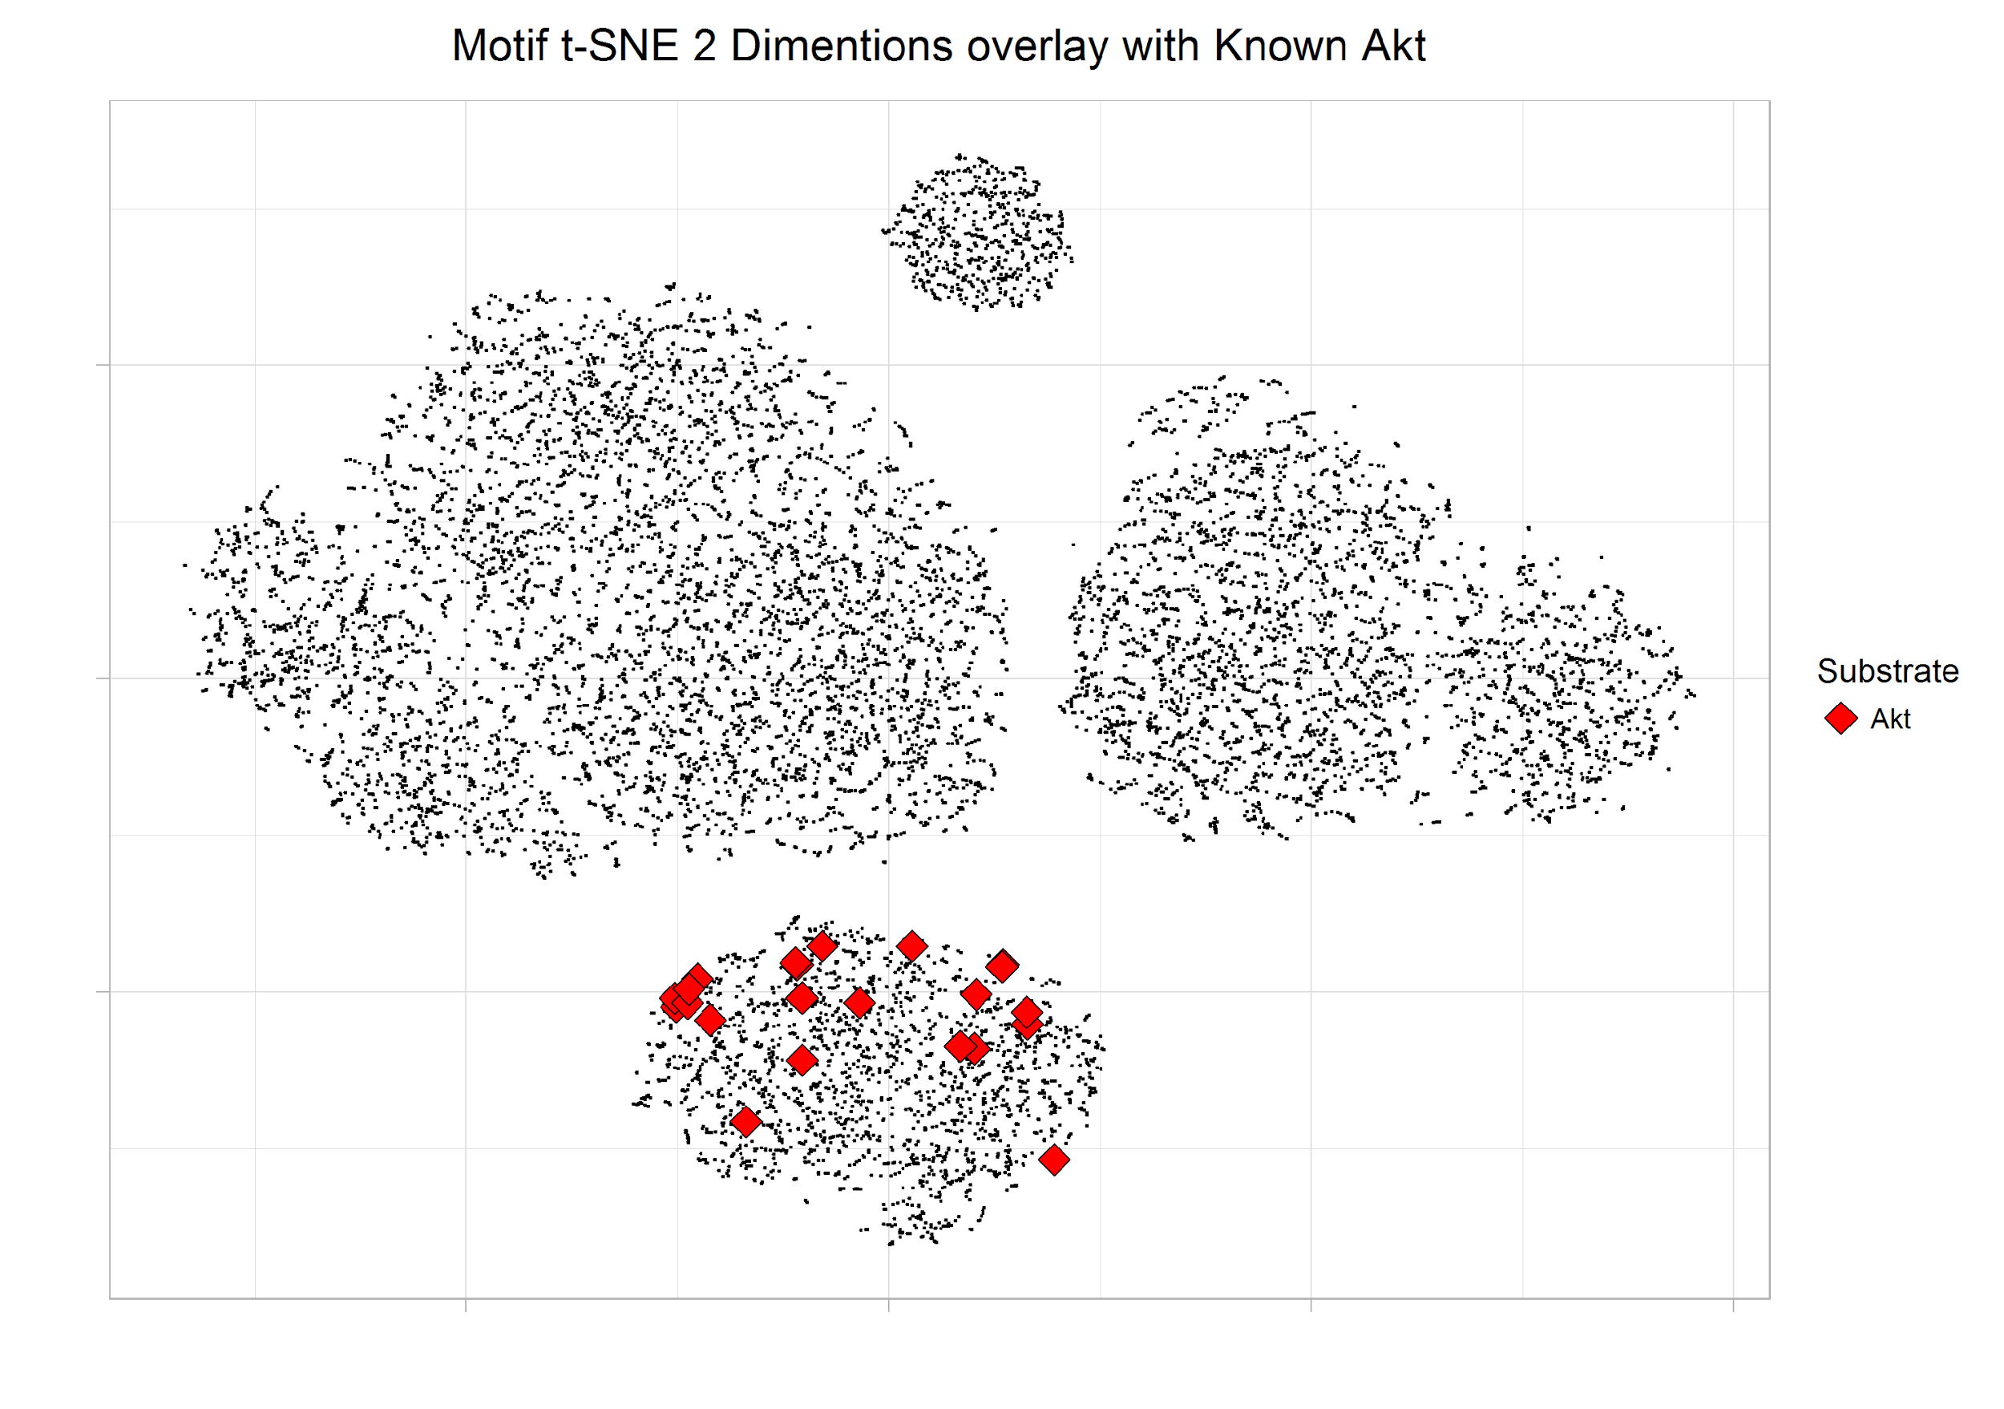
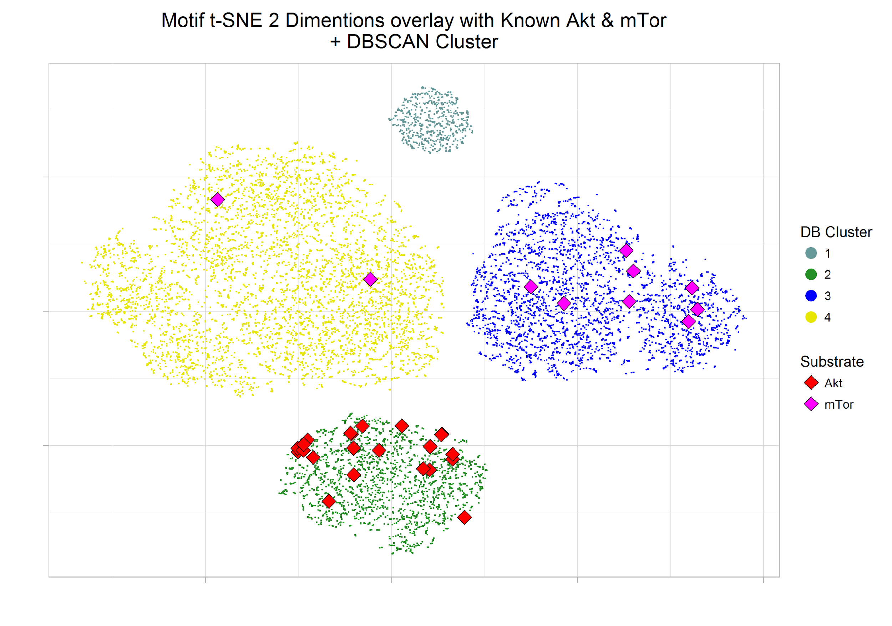
Visualize Sequence Motif in 2 Dimension Space

Slide 4
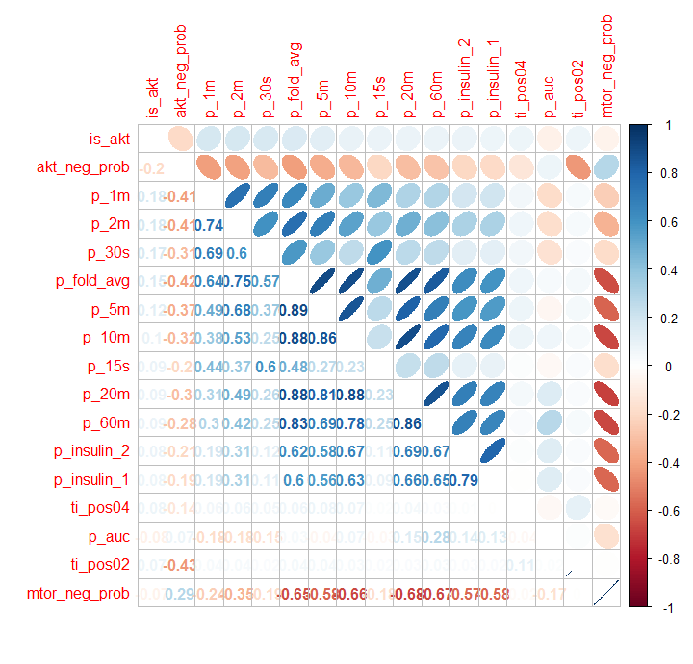
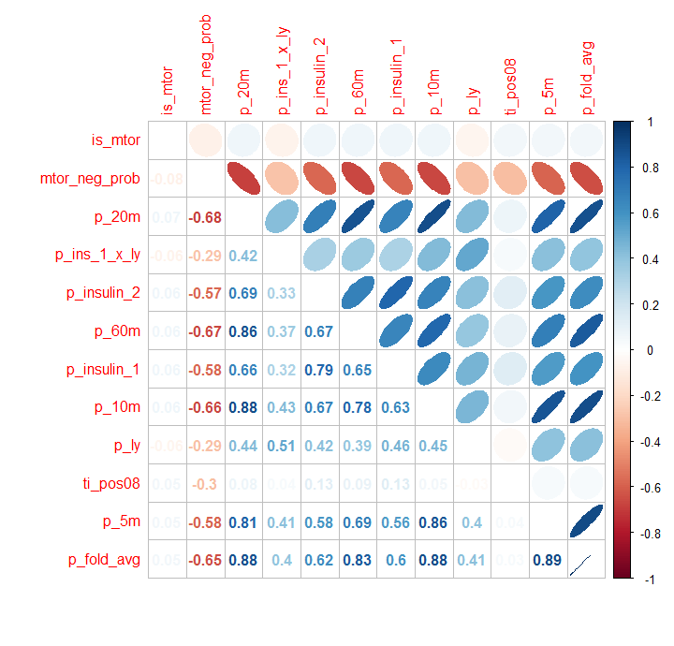
The Correlation Matrix of Class and its Related Variables
Akt and its correlated variables
mTor and its correlated variables

Slide 5
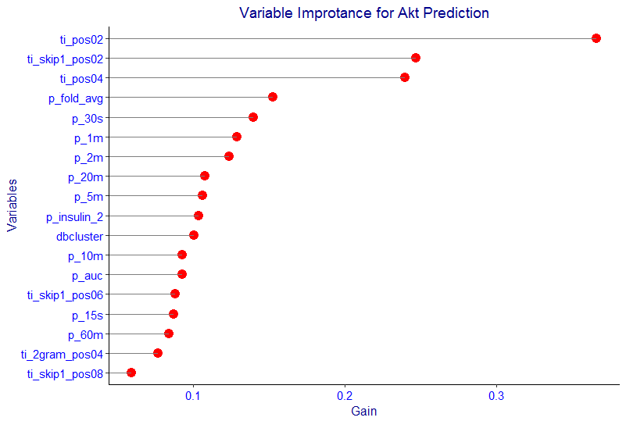
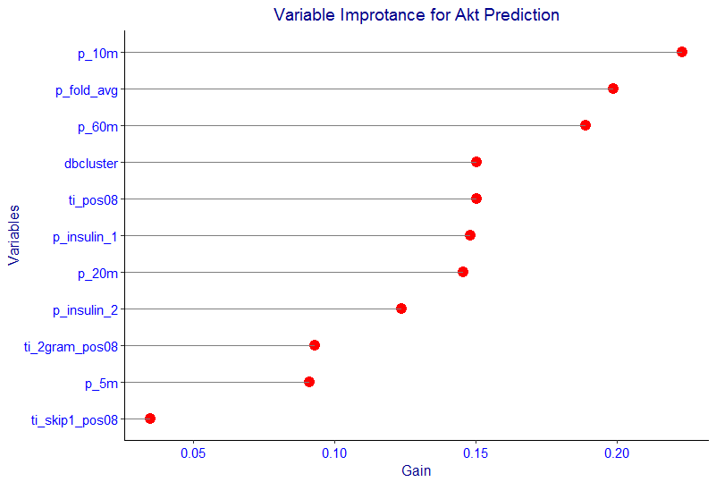
Feature Importance From XGBoost Model
IMportant Features for Akt
Important Features for mTor

Slide 6
Positive-unlabeled Learning
Can we use the known positive data to identify the most possible negative data?
1st approach: Adaptive Sampling (Yang et al., 2017)
2nd approach: Ensemble with Correction factor (Yang et al., 2016)
3rd approach:
Build a Decision Tree Model
Select only trees with 100% sensitivity
Loop through all the available unlabelled data
Do many iteration and select the subgroup of data which never predicted positive

Slide 7
Adaptive Sampling – Ensemble Approach
Apply PCA with certain threshold as 1st parameter.
Iterative sampling using SVM with radial kernel.
Random forest as the final classifier, use 1000 trees and certain percentage of features as 2nd parameter.
Try different combination of parameters and select the one with the best score.
Ensemble of models with Correction Factor
Apply PCA and use 19 principal components.
Ensemble of 200 base classifiers: SVM with polynomial kernel with degree 2.
Validation dataset is used to estimate the correction factor.

Slide 8
Modelling and Consideration on Imbalanced Class Distribution
Build Models on the known positive and screened negative data
Repeated sampling
Random sampling from the majority class (screened negative)
Ensemble classifer
trained 100 base classifers on balanced subsets
SVM (polynomial with degree 2)
Random Forest
XGBoost (Hyperparameter grid search, 3-fold CV,overfitting reducing etc.)
obtained prediction result through majority voting

Slide 9
Using the Decision Tree Model to screen the negative sites by setting sensitivity to 100%
Ensure False Negative is always 0

Slide 10
Evaluation and Benchmarking the Prediction against the Prediction 2016
Strict consideration is enforced for the verdict prediction results.
The XGBoost ensemble built 100 models and the prediction results is based on the vote of 100 outcomes. If vote is > 50 than positive.
The verdict is set to be agreed by all 3 predictions:
With all variables
With motif variables only
With phosphoprotemic valuables only

Slide 11
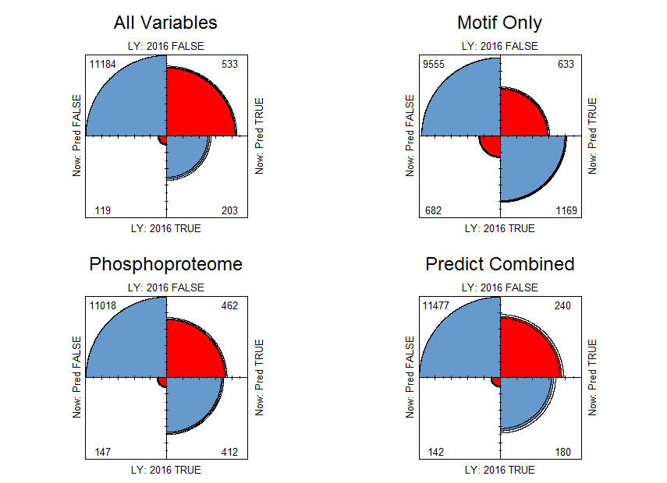
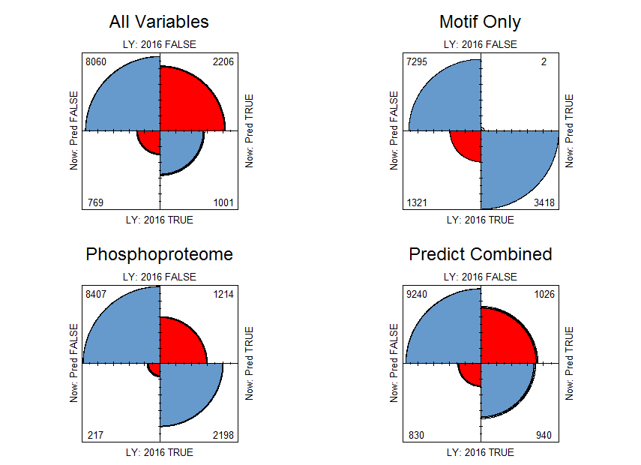
Prediction Confusion Matrix against 2016 Results
Akt Prediction by All Vars, Motif only, Phosphoproteome only, and Verdict
mTor Prediction by All Vars, Motif only, Phosphoproteome only, and Verdict
Note: the matrix scale relativity is based on vertical comparison

Slide 12
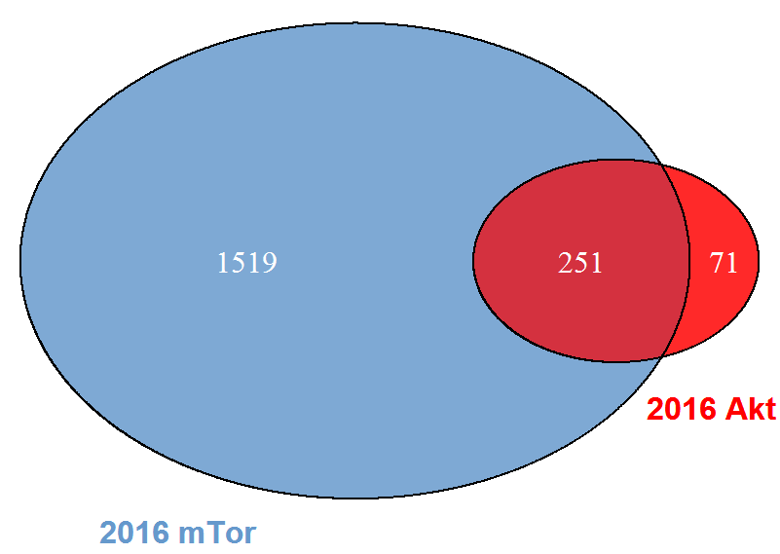
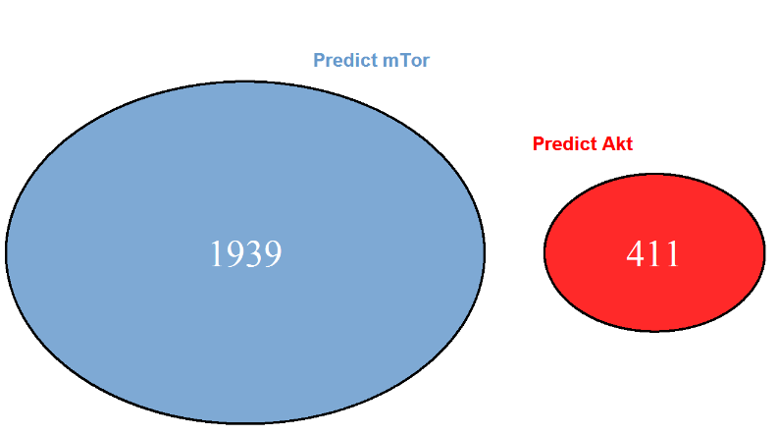
Comparison on Akt vs mTor prediction overlapping
2016 Predict Akt and mTor Overlapping
(Ensemble SVM, 50 models)
New Predict Akt and mTor Overlapping
(Ensemble xgboost, 100 models)
Clearly separated Akt and mTor prediction

Slide 13
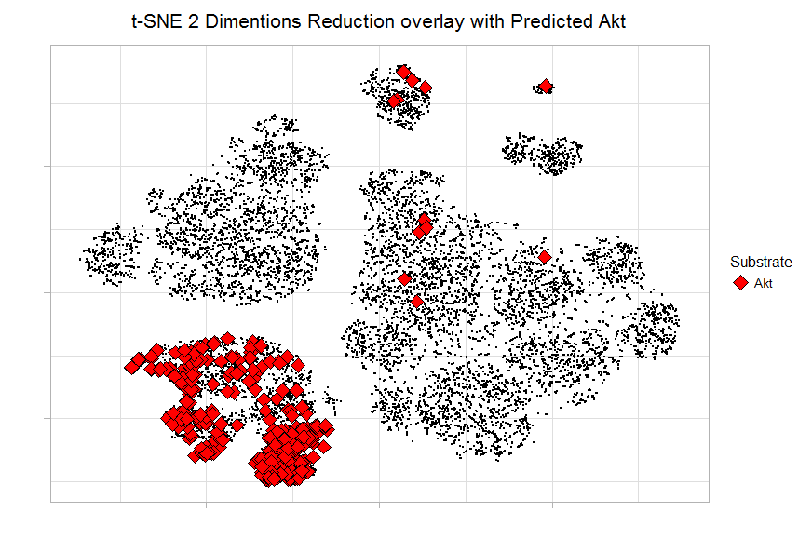
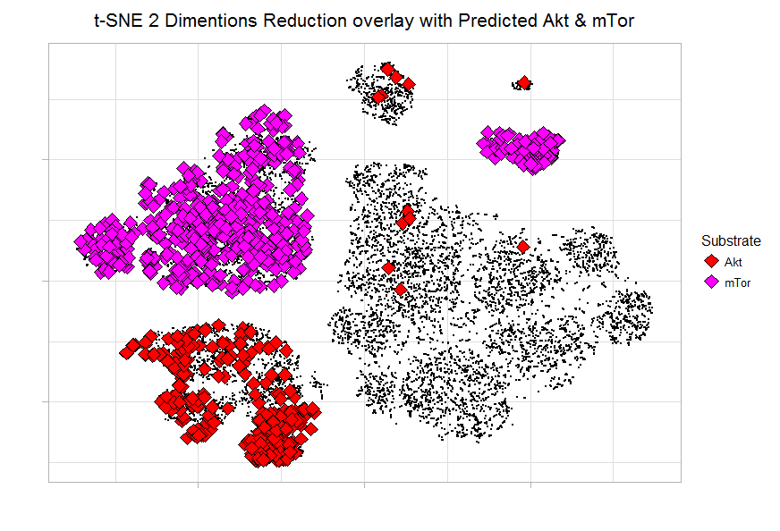
Overlapping Predicted Akt & mTor with tSNE

Slide 14
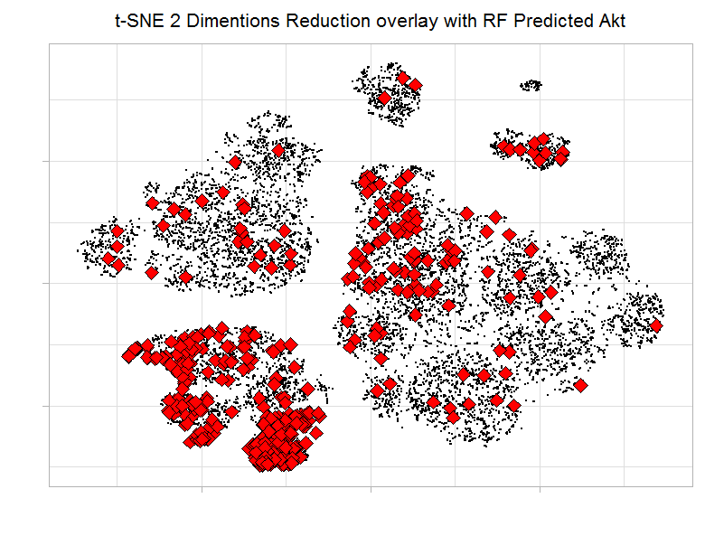
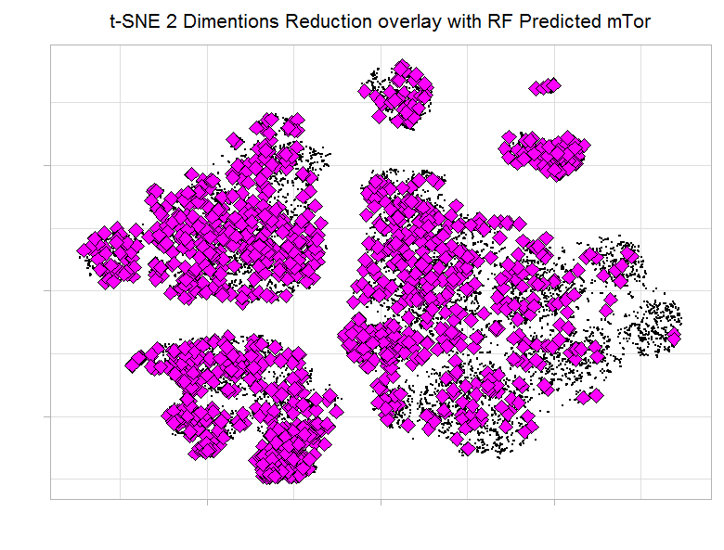
Overlapping Random Forest Predicted Akt & mTor with tSNE

Slide 15
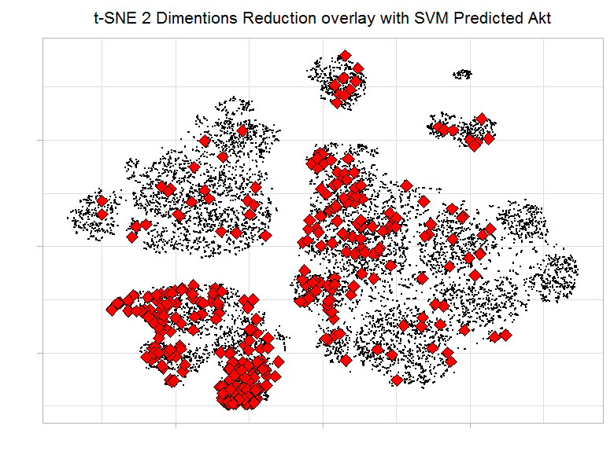
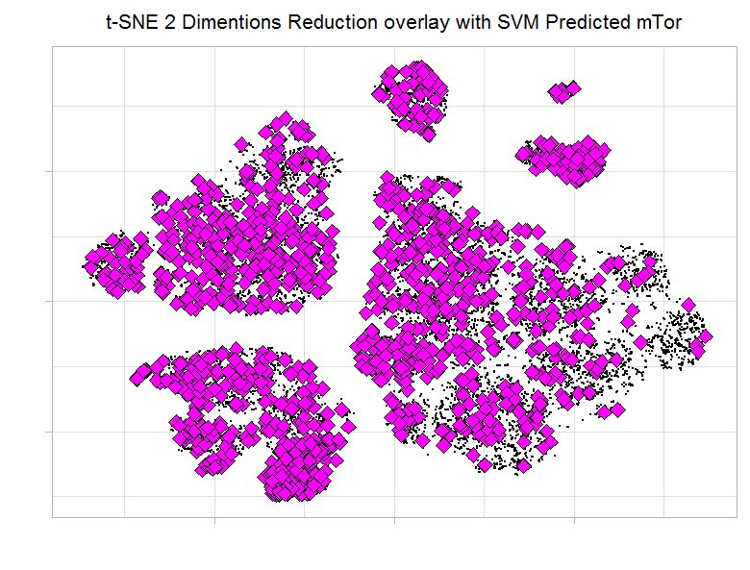
Overlapping SVM Predicted Akt & mTor with tSNE

Slide 16
Thank you

